Slide 1

AIRFLOW
Jobs Monitoring Dashboard
- Automated monitoring and reporting for efficient workflow management.

Slide 2
TEAM MEMBERS
Faculty Trainer: Mr. G S PRASADA REDDY
S NO | ROLL NO | BRANCH | NAME
1 | 22881A05J8 | CSE | VARKALA ABHINAV SURYA
2 | 22881A05F8 | CSE | KATIKA MOHAMMED SHANAWAZ
3 | 22881A05J7 | CSE | THUNIKIPATI MANISH
4 | 22881A1280 | IT | ASHWINI GORUPALLY
5 | 22881A7208 | AI & DS | BOMMAGANI SRIDEVI
6 | 22881A7209 | AI & DS | CHARITHA KATRAGADDA
7 | 22881A7238 | AI & DS | PAUL PAGIDIPALLI
8 | 22881A7248 | AI & DS | PURAM MANJUSHA

Slide 3

Current Challenges
1
Monitoring Difficulty
Lack of comprehensive real-time Dashboard to monitor
the status of all jobs pertaining to an application.
2
Inconsistent Reporting
Manual job execution reporting leads to errors.
3
Delayed Updates
Stakeholders lack timely information on workflow status.
4
Inefficient Troubleshooting
Slow response to workflow issues impacts productivity.

Slide 4
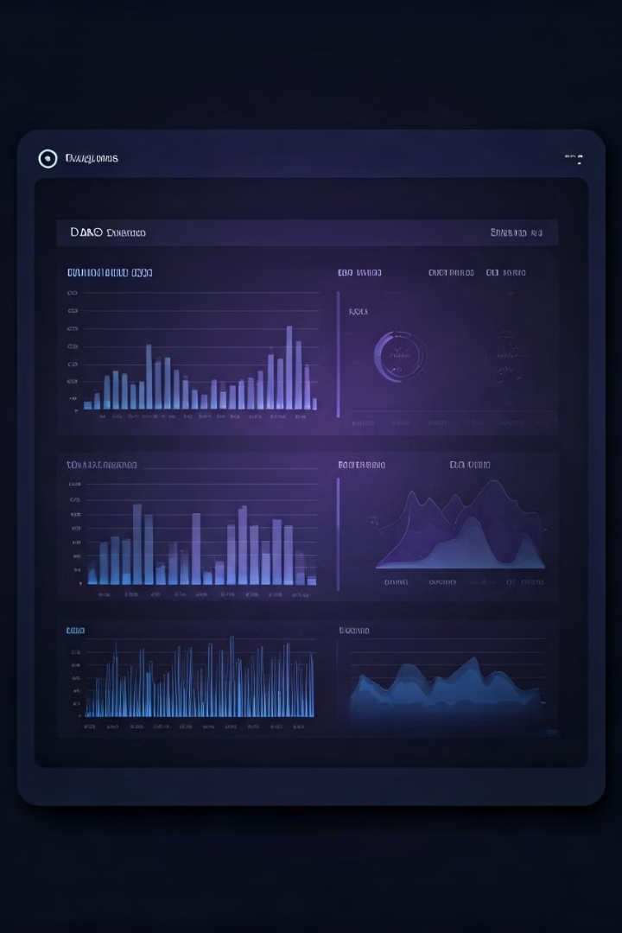
Proposed Solution
1
Real-Time Dashboard
Monitor DAG status across applications instantly.
2
Automated Reporting
Daily job execution reports sent to stakeholders.
3
Intelligent Insights
Automated analysis for quick troubleshooting.

Slide 5
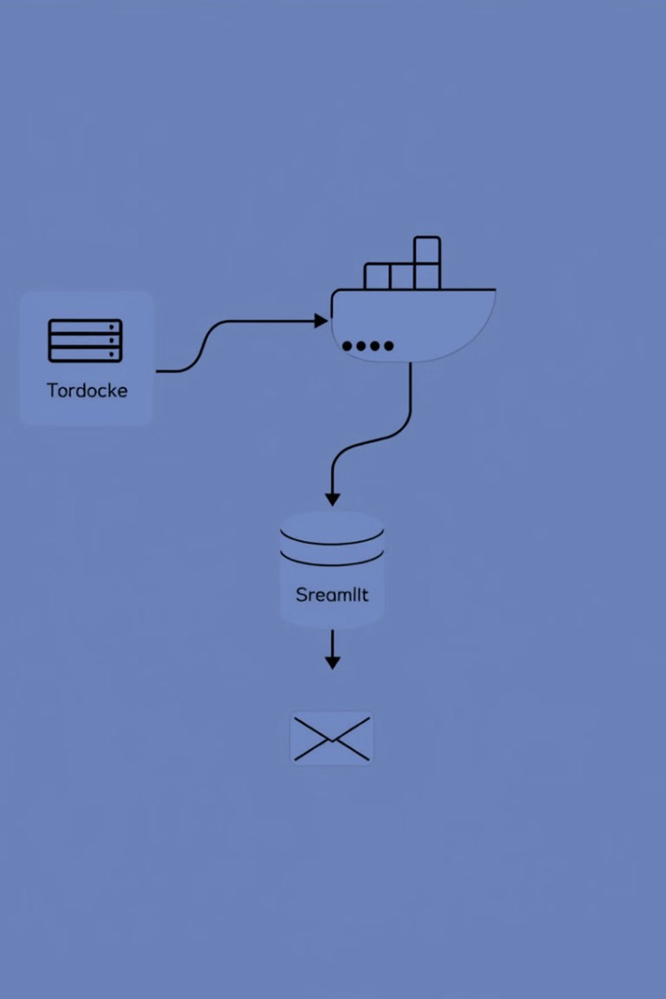








Architecture Overview
PostgreSQL
Data source.
PostgreSQL
Airflow in Docker
Backend processing.
Streamlit
Frontend interface.
Email Service
Status reporting.

Slide 6
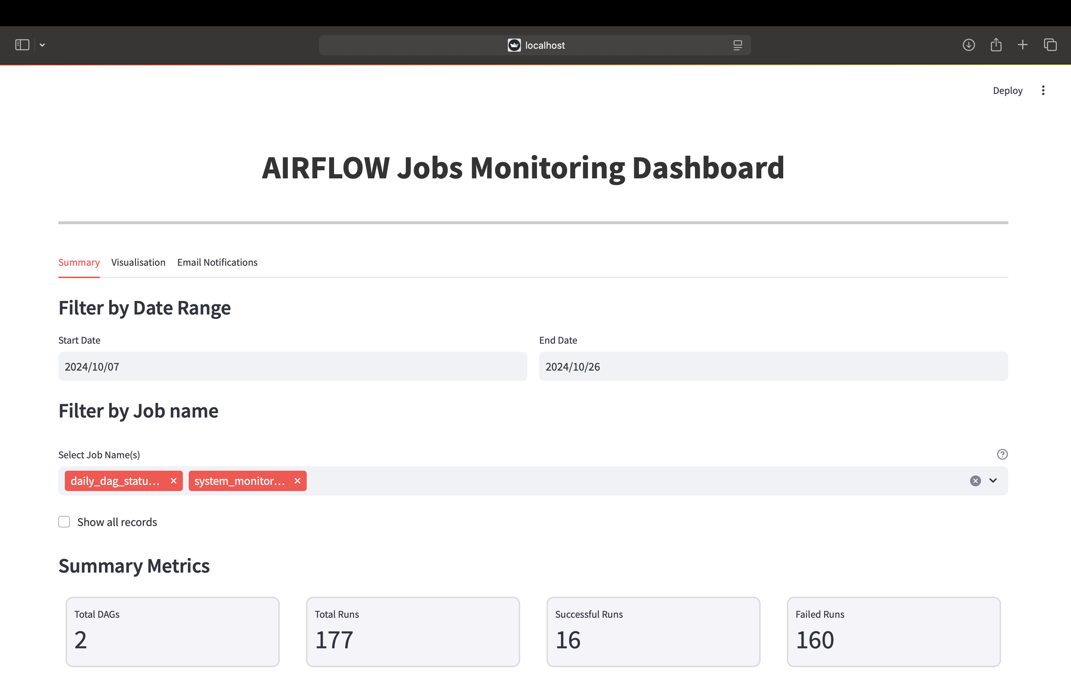

Slide 7
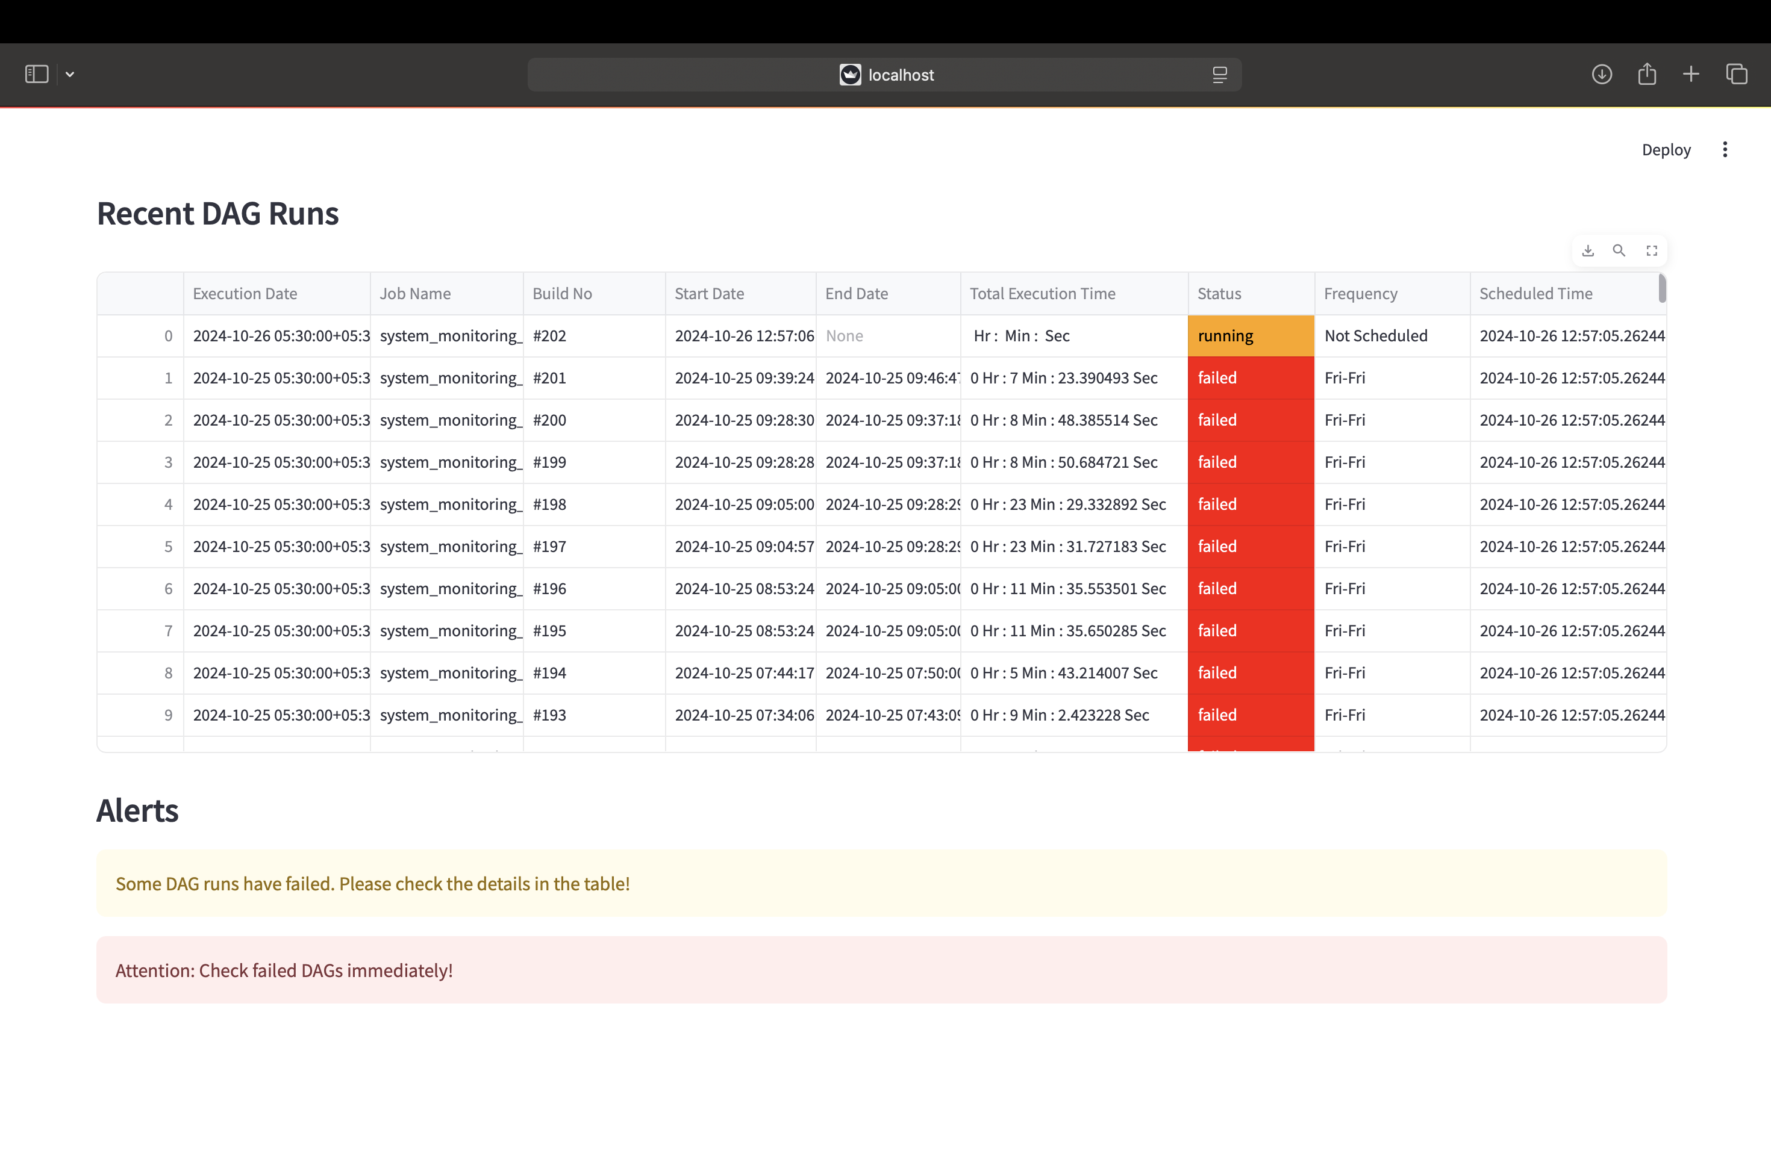

Slide 8
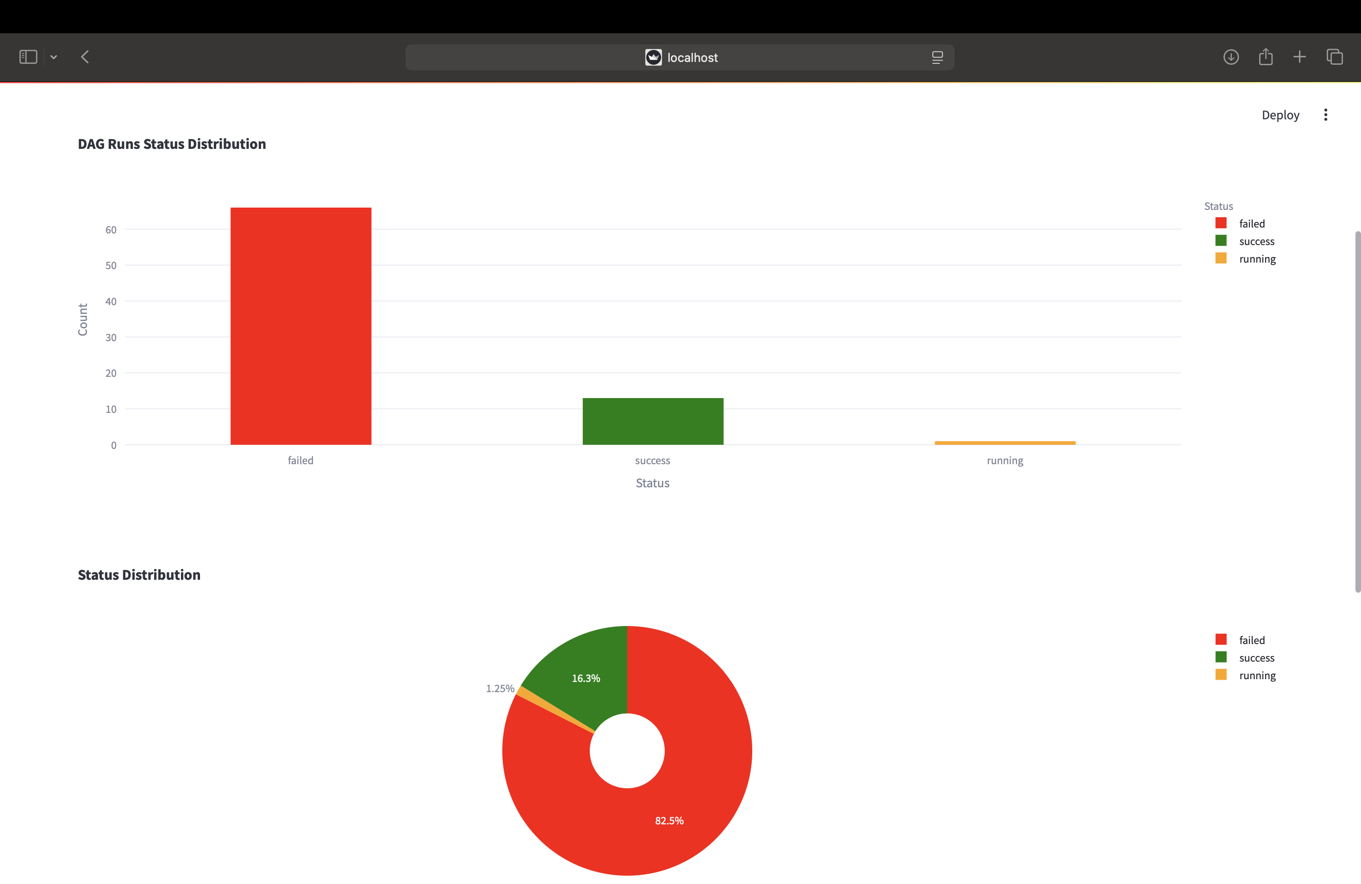

Slide 9
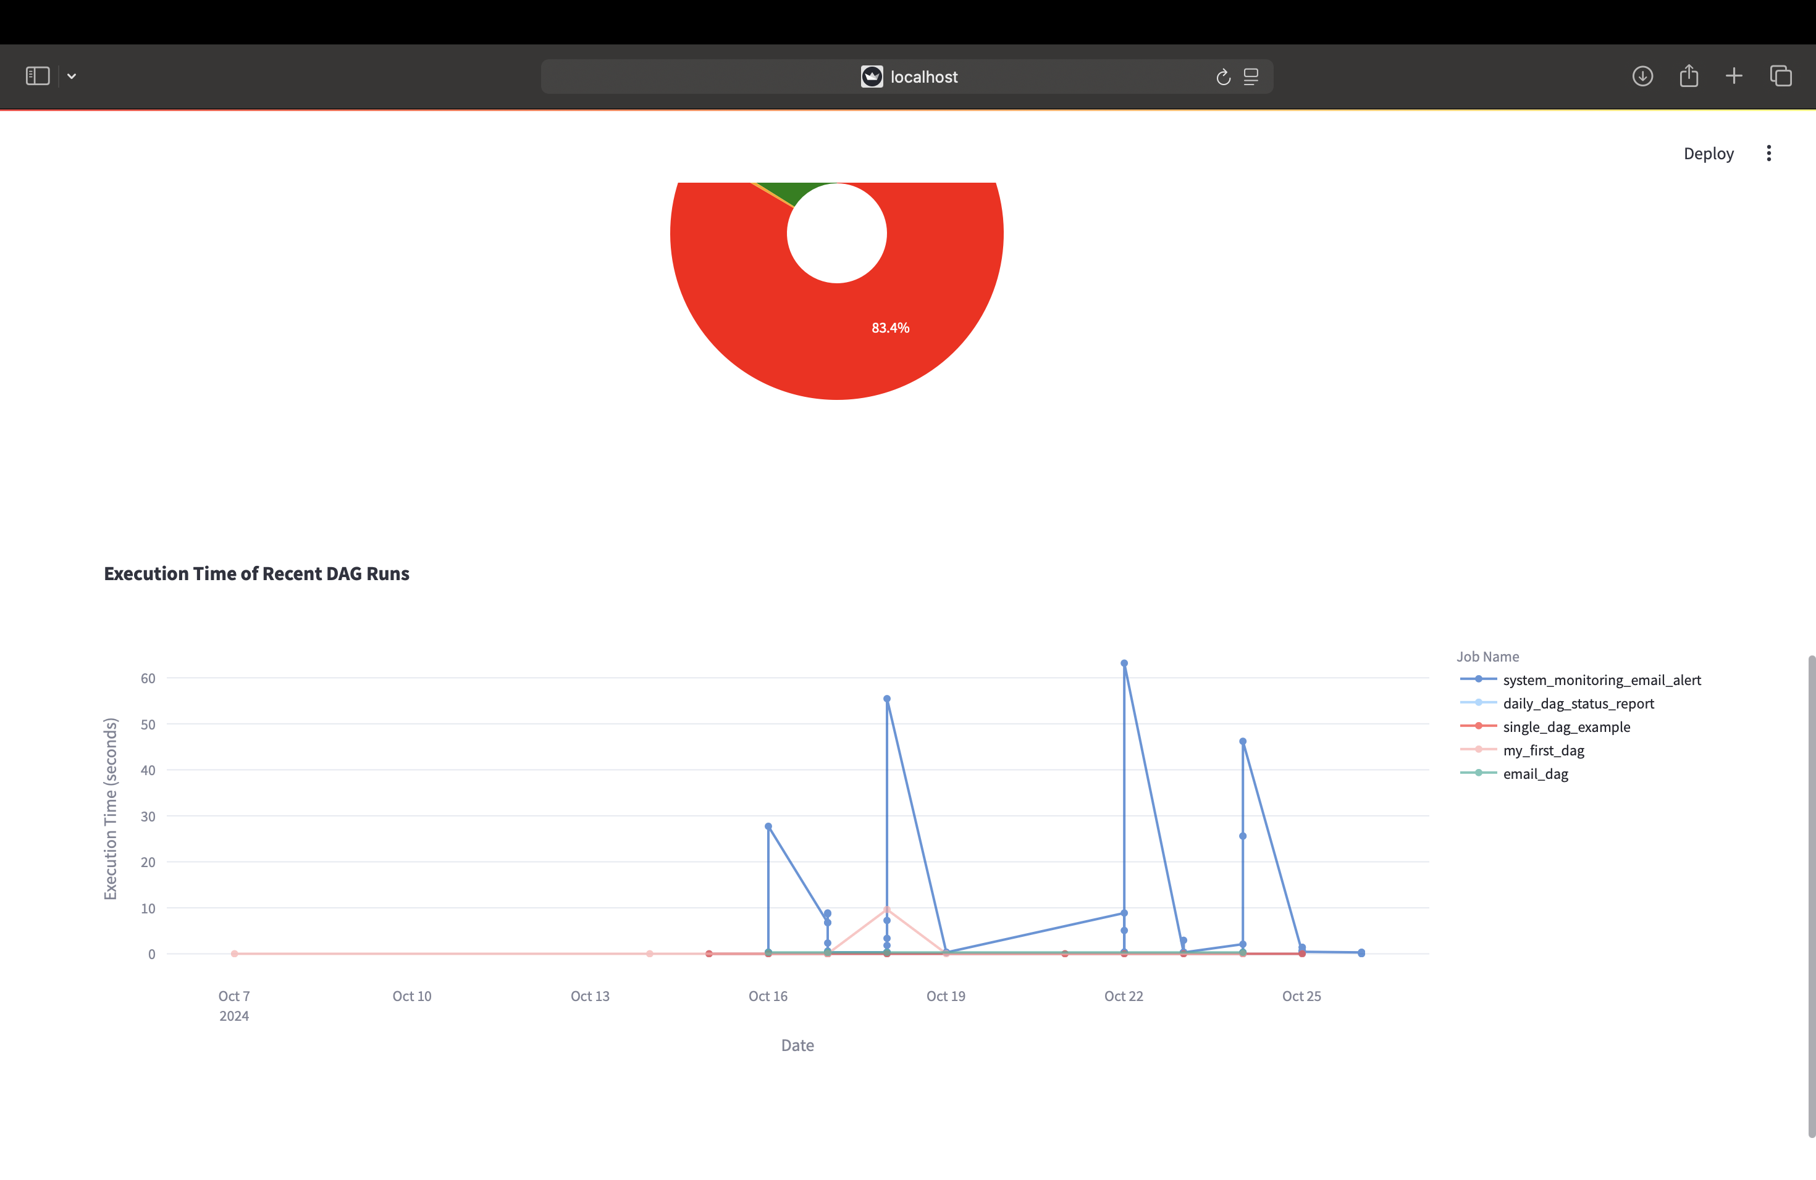

Slide 10
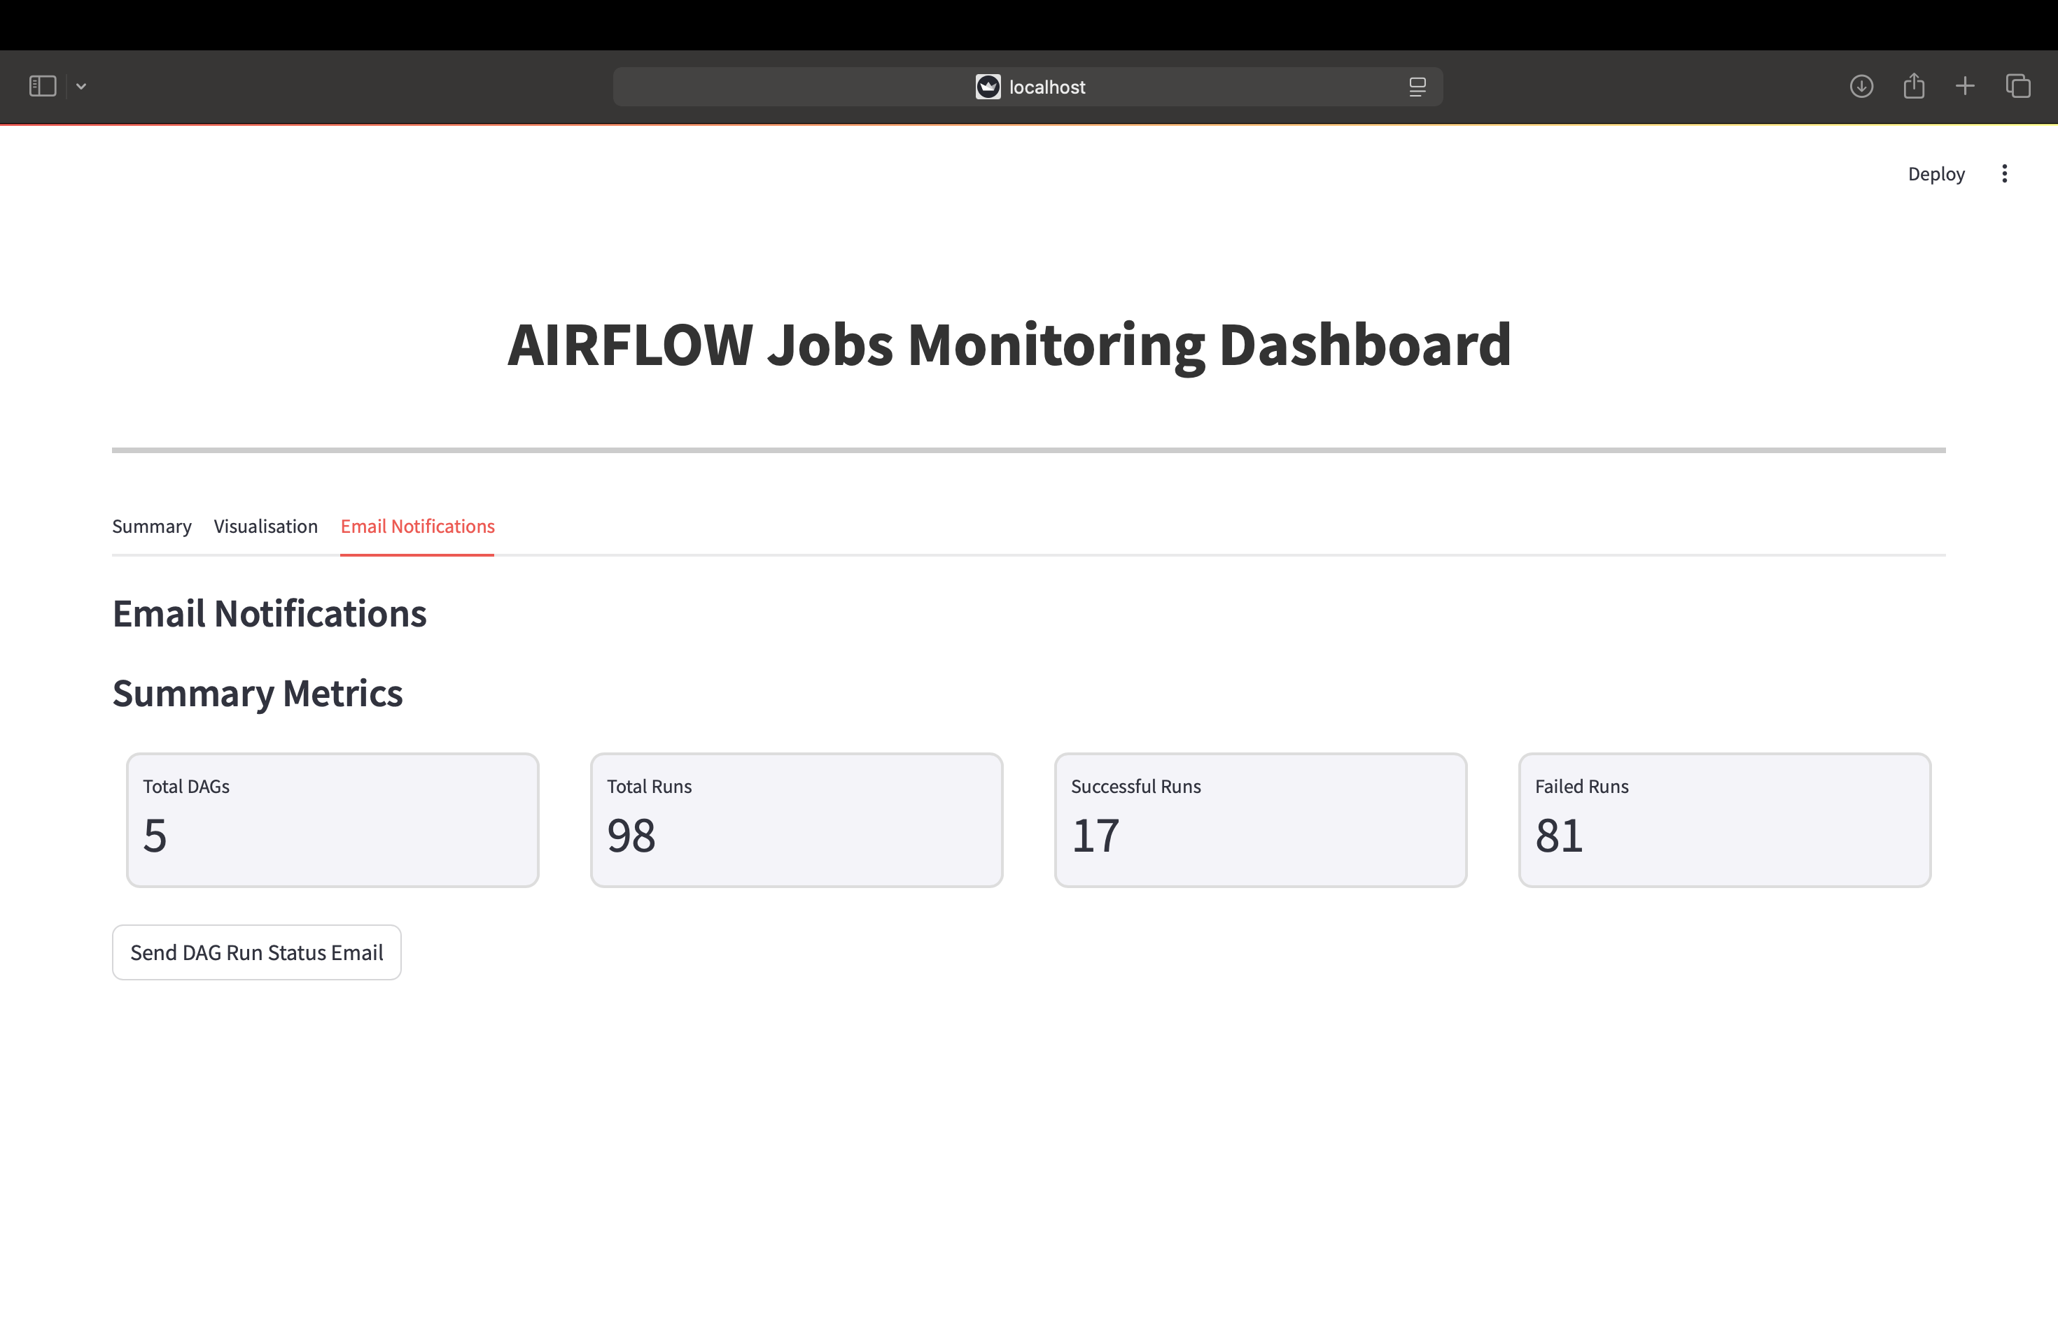

Slide 11
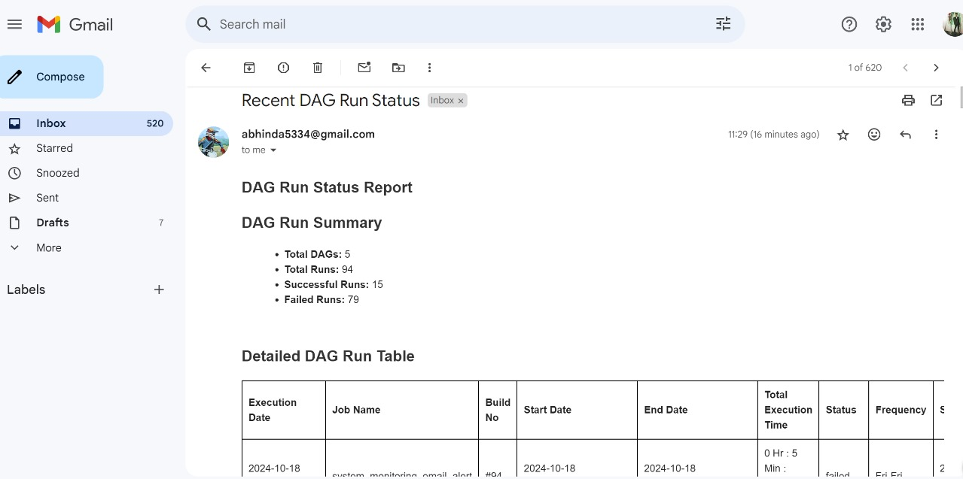

Slide 12
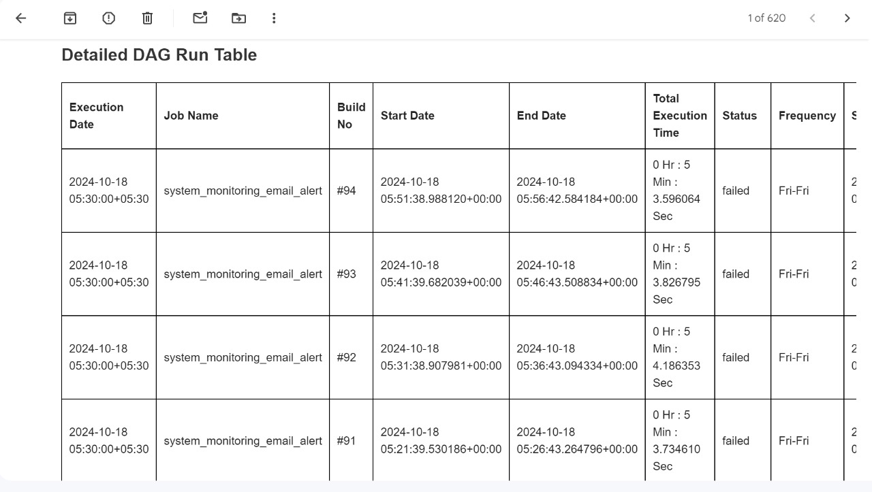

Slide 13
Real-Time DAG Monitoring
Unified Dashboard
Status Visualisation
Detailed Drill-Down
View all active DAGs across applications.
See running, failed, or completed DAG statuses.
Access individual DAG details for troubleshooting.

Slide 14

Job Execution Status Report
Automated Generation
Reports created and distributed without manual intervention.
Comprehensive Updates
All stakeholders informed of job progress.
Flexible Scheduling
Customise report frequency: daily, weekly, or on-demand.

Slide 15
Thank you

